Slide 1
Predicting 2000 Presidential Election Results At the County Level Using Census Data
Mose Wintner
mose.wintner@gmail.com
Kaiser Permanente Health Innovation Studio
April 6, 2018

Slide 2
Problem
Question: Can we use 2000 census data to predict county-level results of the 2000 presidential election?

Slide 3
Problem
Question: Can we use 2000 census data to predict county-level results of the 2000 presidential election?
Bonus question: How well do our models generalize to the 2004 and 2008 elections?

Slide 4
Problem
Question: Can we use 2000 census data to predict county-level results of the 2000 presidential election?
Bonus question: How well do our models generalize to the 2004 and 2008 elections?
Even more interesting bonus question: Which variables collected by the census are most predictive of the presidential election vote in a given county?

Slide 5
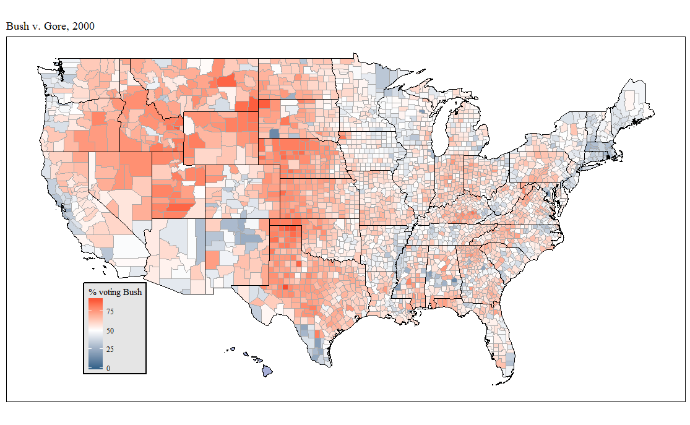

Slide 6
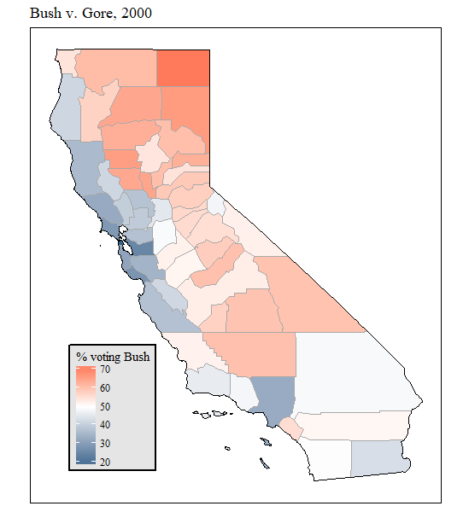
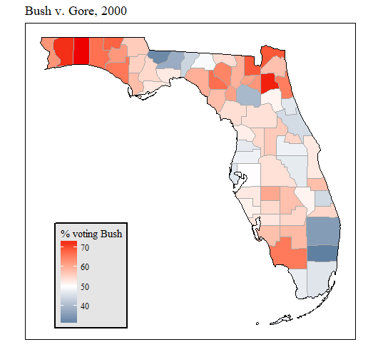

Slide 7
The data
After cleaning data, 3125 counties.

Slide 8
The data
After cleaning data, 3125 counties.
Used 39 total variables/predictors consisting of demographic data, housing data, labor data, public data (i.e. data about government activities) and features engineered from those.

Slide 9
The data
After cleaning data, 3125 counties.
Used 39 total variables/predictors consisting of demographic data, housing data, labor data, public data (i.e. data about government activities) and features engineered from those.
All data except latitude and longitude came from the U.S. Census Bureau's (unmaintained) Counties Database at http://www.census.gov/support/USACdataDownloads.html.

Slide 10
Variable | Description | Variable | Description
rpct | % vote for Bush in 2000 | 20 age20_34 | % aged 20-34
1 hs | % of county with HS diploma | 21 age35_54 | % aged 35-54
2 nohealthinsurance | % without health insurance | 22 age55_ov | % aged 55+
3 vehperhouse | avg. # vehicles per house | 23 vcperpop | # known violent crimes per 1000 population
4 poverty | % below poverty line | 24 homeaffordability | per capita income / median home value
5 bluecollaroccs | % farming, fishing, forestry, construction, maintenance, production, transportation, extraction occupations | 25 urban | % living in urban areas
6 flow10yr | % population change 1990-2000 | 26 farm | % living in rural farm areas
7 white1nh | % white only and non-Hispanic | 27 voterparticip | voter participation rate
8 afam1 | % African-American only | 28 houseperpop | # houses per population
9 asian1 | % Asian only | 29 logincollege | log(% of county in college)
10 other1 | % other race | 30 logba | log(% of county with Bachelor's degree)
11 multirace | % multiracial | 31 logpctmultiunitdwelling | log(% of houses w/2+ units)
12 Hispanic | % Hispanic of any race | 32 logmedianhvalue | log(median home value)
13 lat | latitude of county centroid | 33 logmediangrossrent | log(median gross rent)
14 long | longitude of county centroid | 34 logunemployed | log(% of civilian labor force unemployed)
15 nevermarried | % never married | 35 logpci | log(per capita income)
16 married | % currently married | 36 logforeignborn | log(% of county born outside US)
17 sepdiv | % separated or divorced | 37 lognonenglish | log(% speaking non-English language at home)
18 logpop | log(population in 2000) | 38 loglandsqmi | log(land area in square miles)
19 logpoppersqmi | log(population density in 2000) | 39 loghomeless | log(% homeless in county)

Slide 11
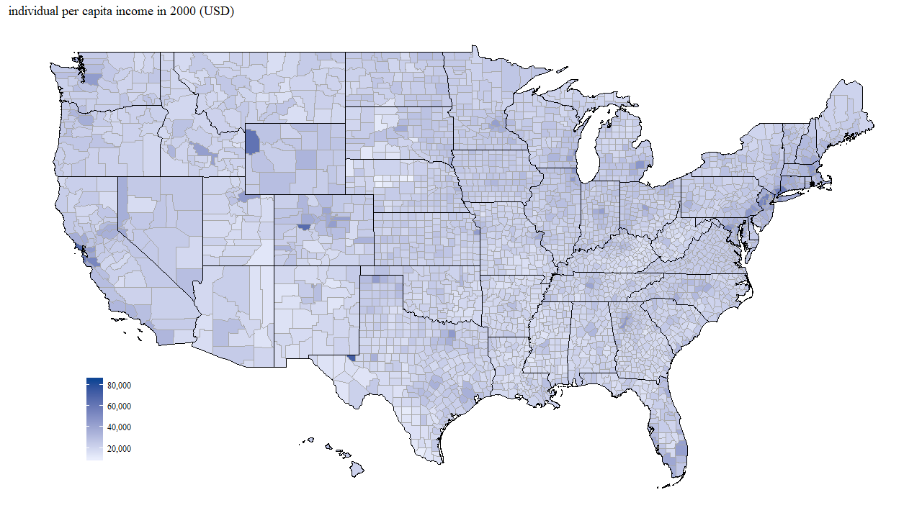

Slide 12
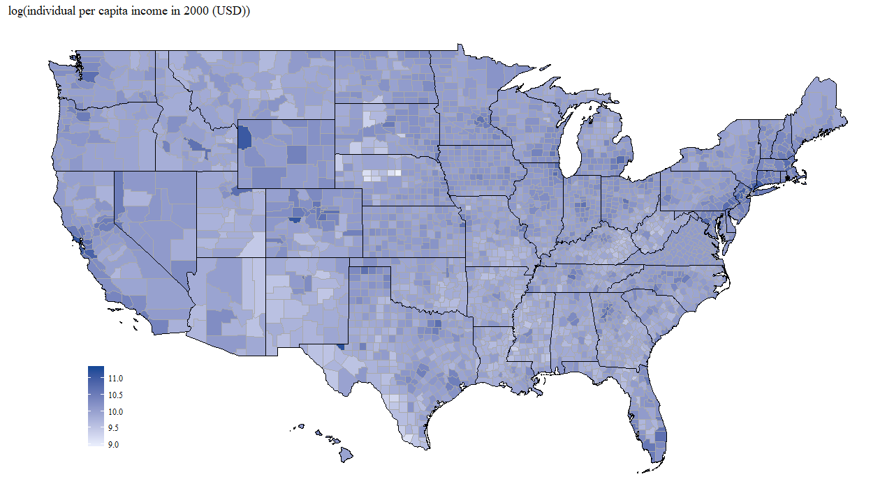

Slide 13
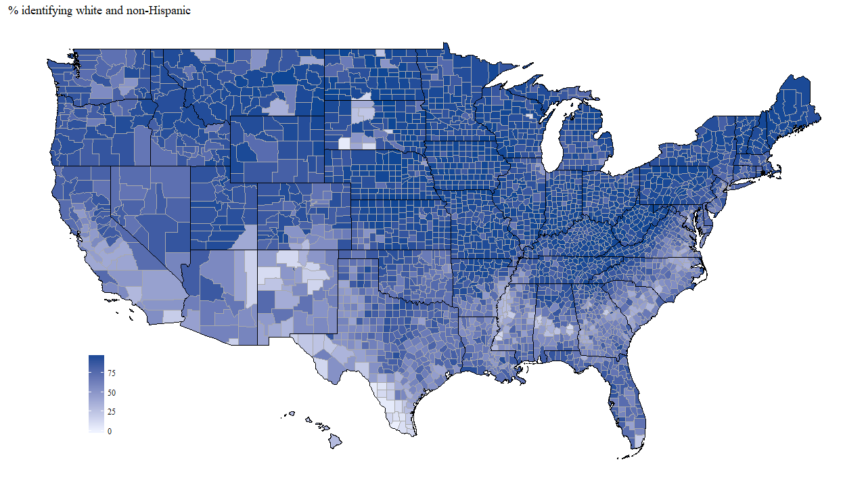

Slide 14
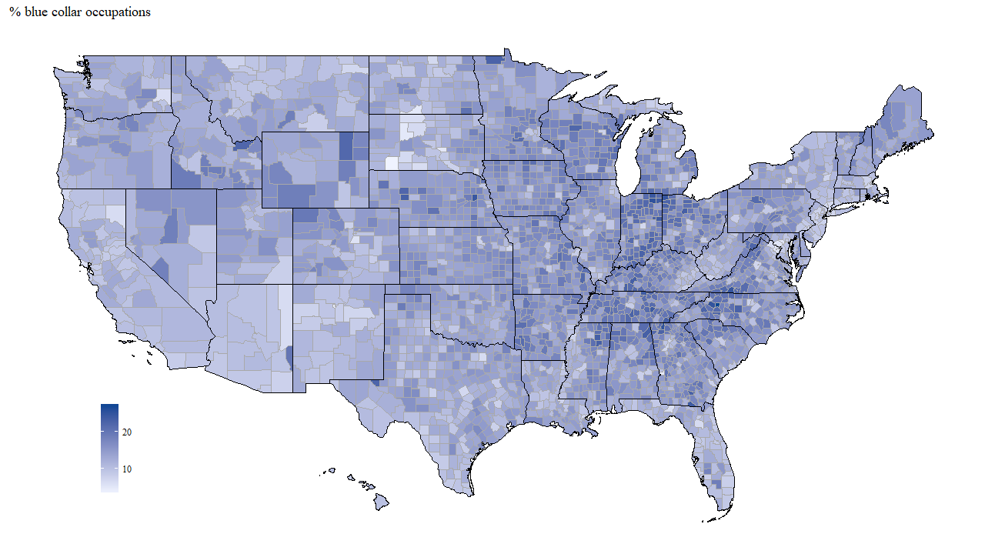

Slide 15
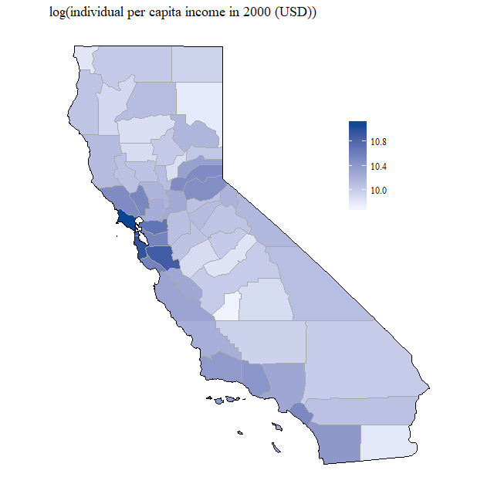
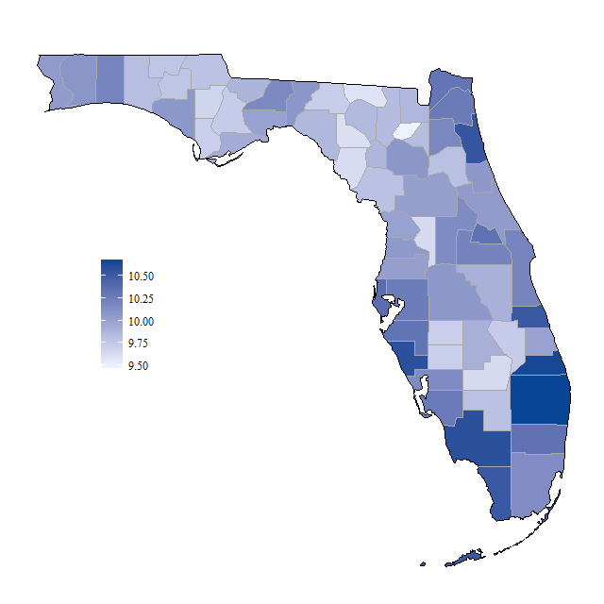

Slide 16
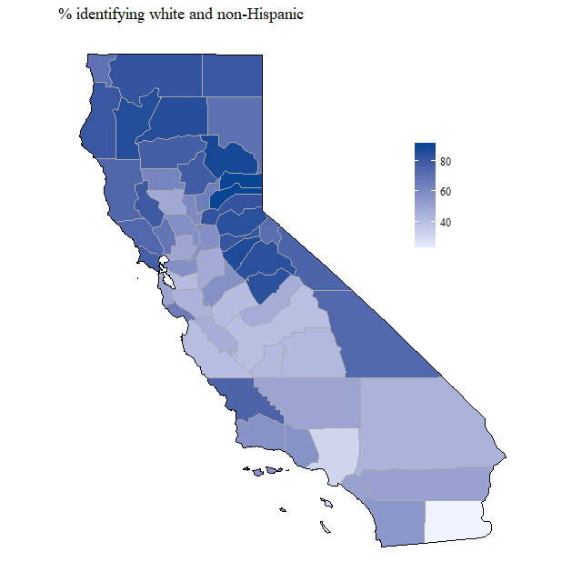
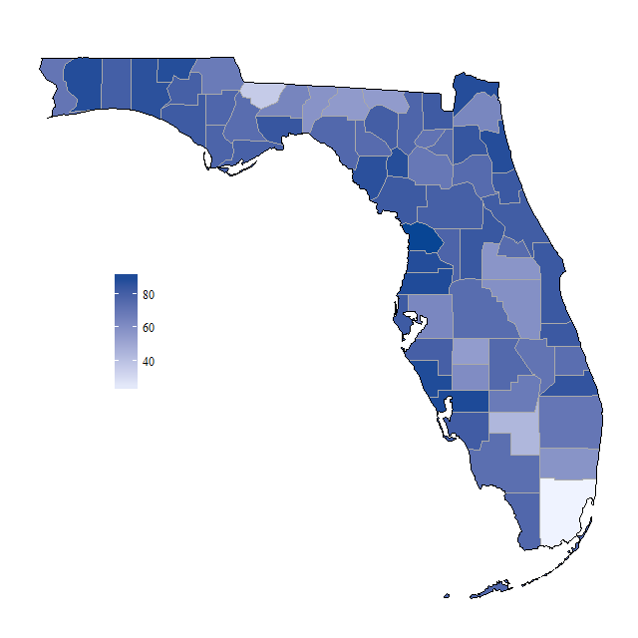

Slide 17
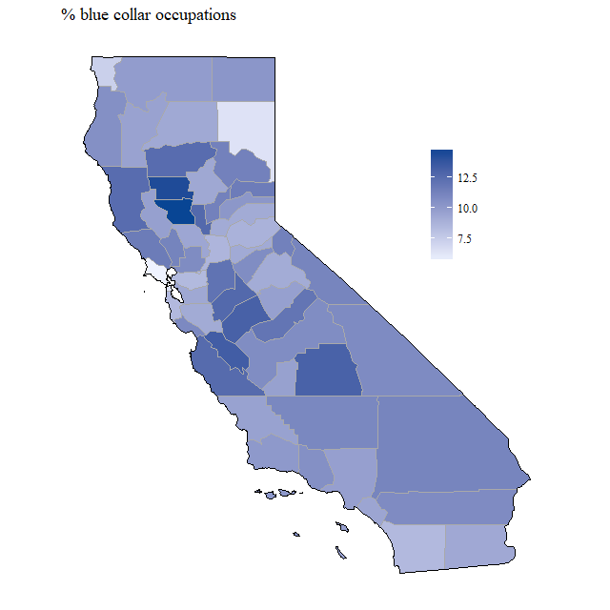
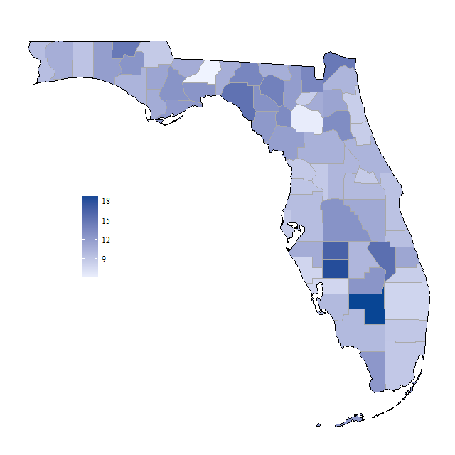

Slide 18
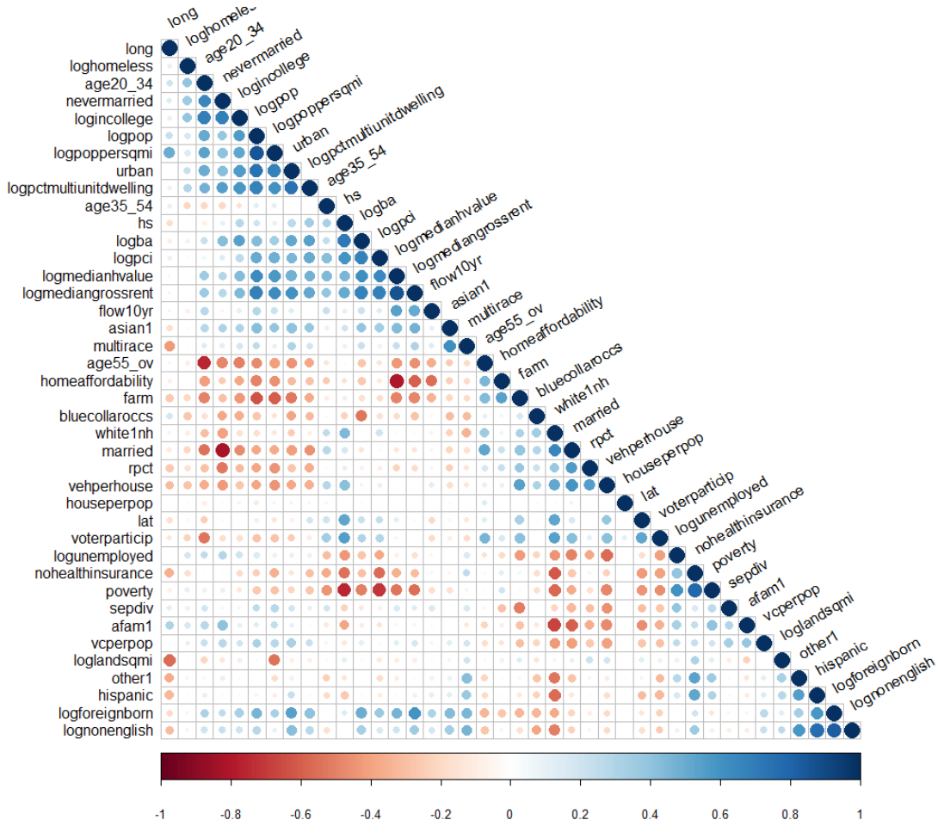
Correlation
plot

Slide 19
Predicting election results: Model selection
Chose algorithmically from several candidate models

Slide 20
Predicting election results: Model selection
Chose algorithmically from several candidate models.
Goodness of fit measure:
R²=correlation(rpct, prediction)²

Slide 21
Predicting election results: Model selection
10-fold cross validation
Randomly divide set of all counties into 10 equally sized groups.

Slide 22
Predicting election results: Model selection
10-fold cross validation
Randomly divide set of all counties into 10 equally sized groups.
For each candidate model m,
For each group of counties g,

Slide 23
Predicting election results: Model selection
10-fold cross validation
Randomly divide set of all counties into 10 equally sized groups.
For each candidate model m,
For each group of counties g,
i. “Train” an instance of m by observing relationships between census data and vote split in the other 9 groups, setting g aside.

Slide 24
Predicting election results: Model selection
10-fold cross validation
Randomly divide set of all counties into 10 equally sized groups.
For each candidate model m,
For each group of counties g,
i. “Train” an instance of m by observing relationships between census data and vote split in the other 9 groups, setting g aside.
ii. Use this trained instance of m to predict county vote for each county in group g.

Slide 25
Predicting election results: Model selection
10-fold cross validation
Randomly divide set of all counties into 10 equally sized groups.
For each candidate model m,
For each group of counties g,
i. “Train” an instance of m by observing relationships between census data and vote split in the other 9 groups, setting g aside.
ii. Use this trained instance of m to predict county vote for each county in group g.
iii. Record the goodness of fit of candidate model m on the counties in g.

Slide 26
Predicting election results: Model selection
10-fold cross validation
Randomly divide set of all counties into 10 equally sized groups.
For each candidate model m,
For each group of counties g,
i. “Train” an instance of m by observing relationships between census data and vote split in the other 9 groups, setting g aside.
ii. Use this trained instance of m to predict county vote for each county in group g.
iii. Record the goodness of fit of candidate model m on the counties in g.
b. Take the average goodness of fit of the candidate model m across all groups g.

Slide 27
Predicting election results: Model selection
10-fold cross validation
Randomly divide set of all counties into 10 equally sized groups.
For each candidate model m,
For each group of counties g,
i. “Train” an instance of m by observing relationships between census data and vote split in the other 9 groups, setting g aside.
ii. Use this trained instance of m to predict county vote for each county in group g.
iii. Record the goodness of fit of candidate model m on the counties in g.
Take the average goodness of fit of the candidate model m across all groups g.
Choose the best-performing candidate model.

Slide 28
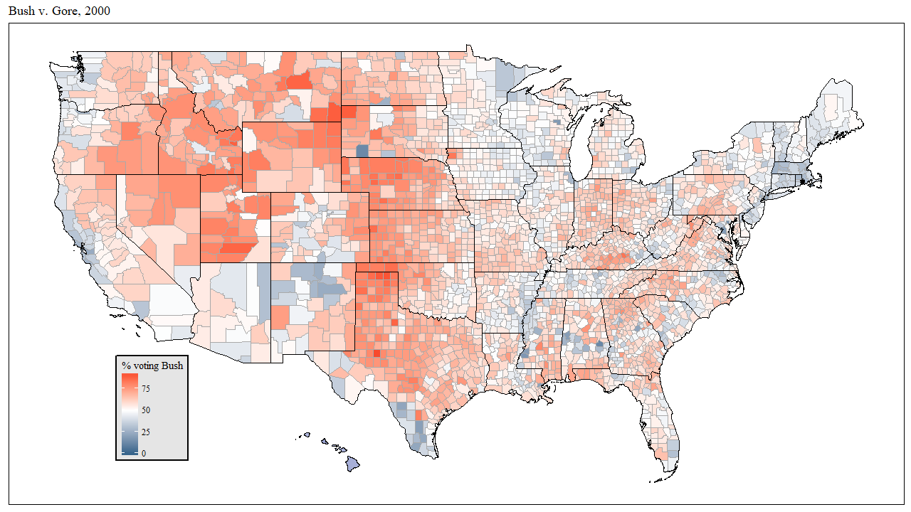
Goodness of fit = 0.77

Slide 29
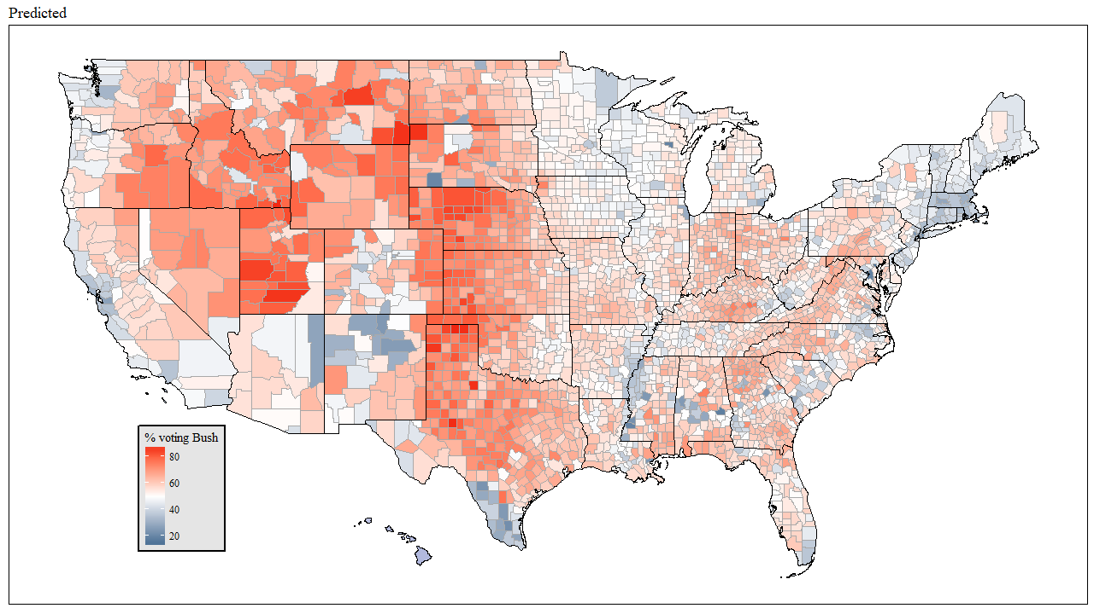
Goodness of fit = 0.77

Slide 30
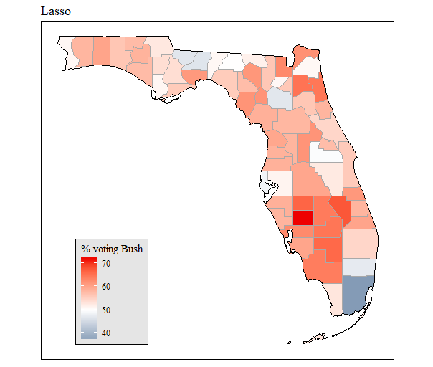
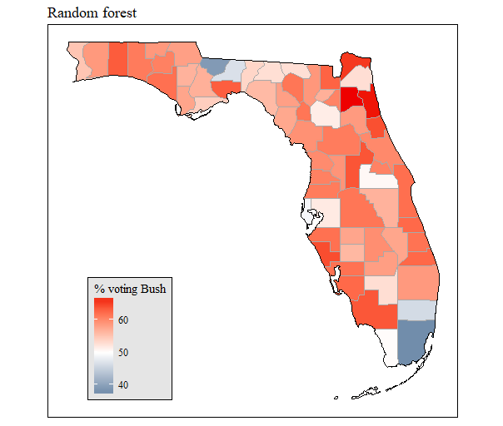
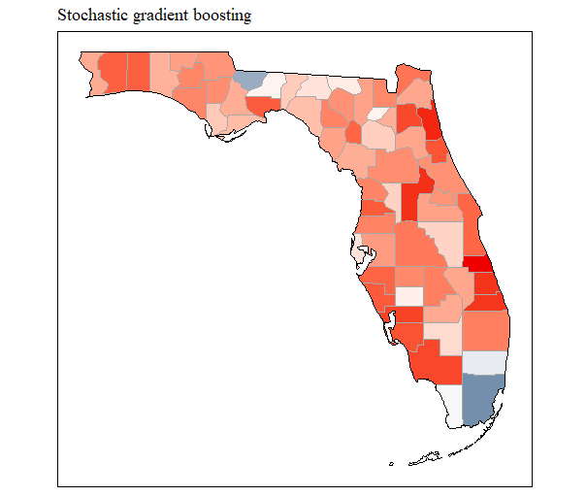
Predictions: Florida, 2000
Models trained on all non-Florida counties

Slide 31
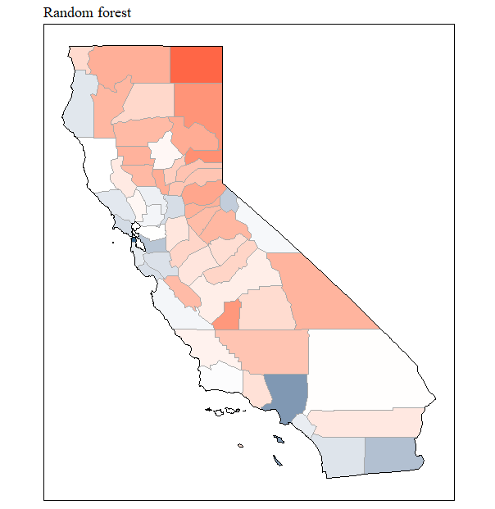
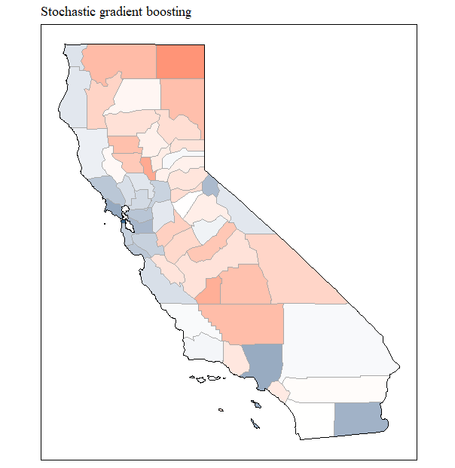
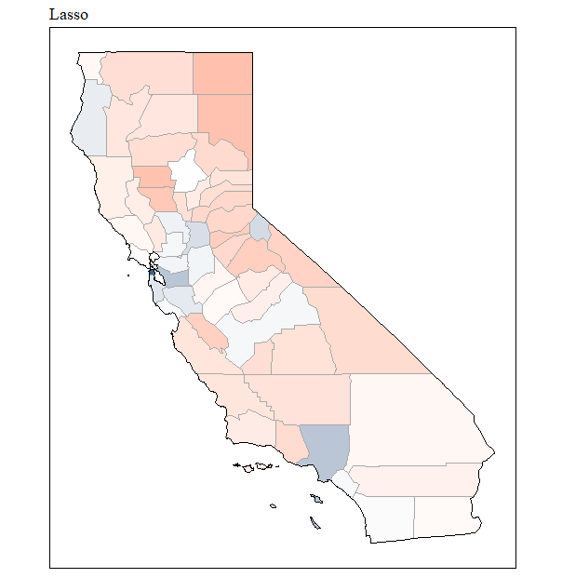
Predictions:
California

Slide 32
Results
Metric \ Model | Generalized linear | Random forest | Stochastic gradient boosting
Goodness of fit | 0.631 | 0.744 | 0.772
Most predictive/ important variables, in descending order of importance (model-dependent) | white1nh vehperhouse lat nohealthinsurance married age55_ov logba logpoppersqmi | long lat white1nh nevermarried voterparticip sepdiv vehperhouse medianhvalue | nevermarried long white1nh vehperhouse lat logpoppersqmi married sepdiv

